Slide 1
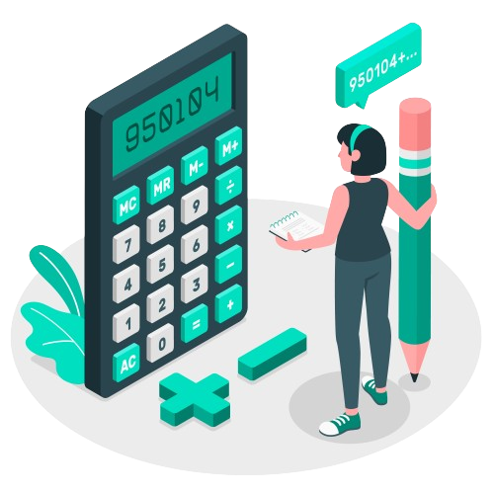
Developing Basic Calculator
Using Tkinter Library
By :- Deewankar Sharma

Slide 2

Project Overview
The Python Calculator project aims to create a simple calculator application with a graphical user interface (GUI) using the Tkinter library in Python. The calculator will be capable of performing basic arithmetic operations such as addition, subtraction, multiplication, and division and it should have a user-friendly interface.

Slide 3
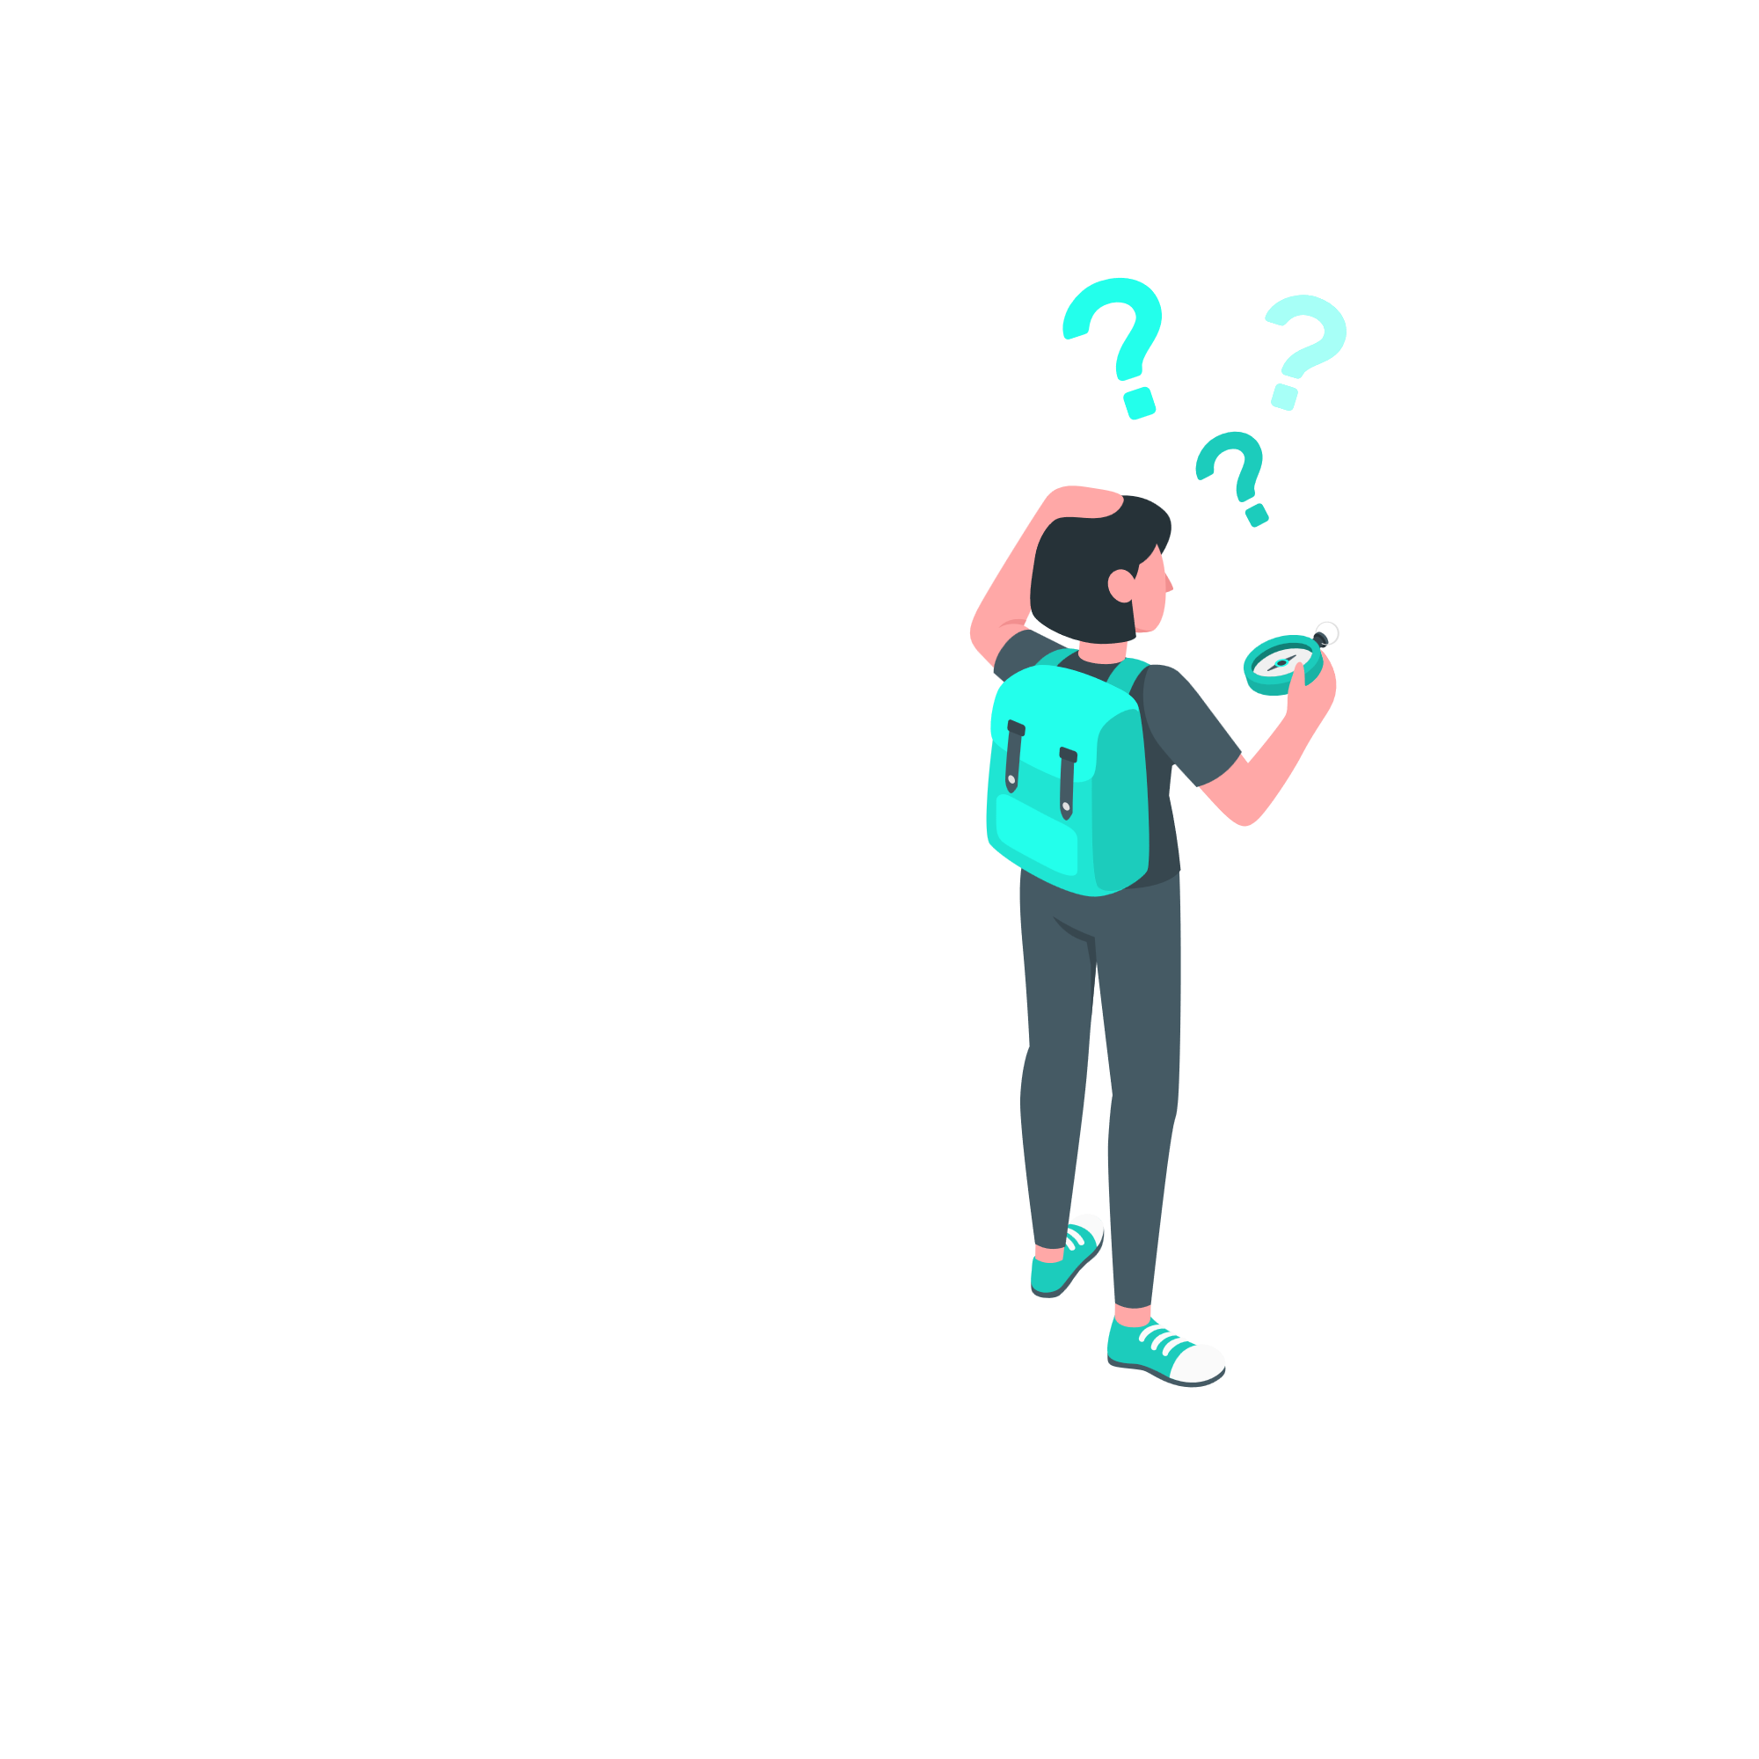
Problem Statement
The Python calculator project aims to solve the issue of lacking a fundamental and intuitive tool for executing essential mathematical operations.
Numerous users—students, professionals, and people in a variety of fields—often need a simple, rapid way to execute arithmetic operations without having to use laborious mathematical software or manual calculations.
But not everyone is experienced with or at ease using command-line calculators; for this reason, graphical user interfaces, or GUIs, can offer a more straightforward and user-friendly experience.

Slide 4

Solution
The Python calculator project offers an easy-to-use graphical user interface (GUI) application as a solution for arithmetic computations.
The project makes it possible to create a graphical calculator with buttons for numbers, arithmetic operators, and functions like equals and clear by applying the Tkinter framework.
This enables users to enter mathematical formulas using button-pressing interactions that are recognisable from traditional calculators.

Slide 5

Key Features
Graphical User Interface (GUI): The calculator will have a user-friendly interface with buttons for numerical values and mathematical operations.
Equation Display Area: The calculator will display the mathematical expressions and their respective results in a designated area.
Core Mathematical Operations: The calculator will support addition, subtraction, multiplication, and division.
Seamless Execution: The calculator will execute mathematical calculations seamlessly and display results accurately.
Clear Functionality: The calculator will have a clear button to clear the equation display area.

Slide 6
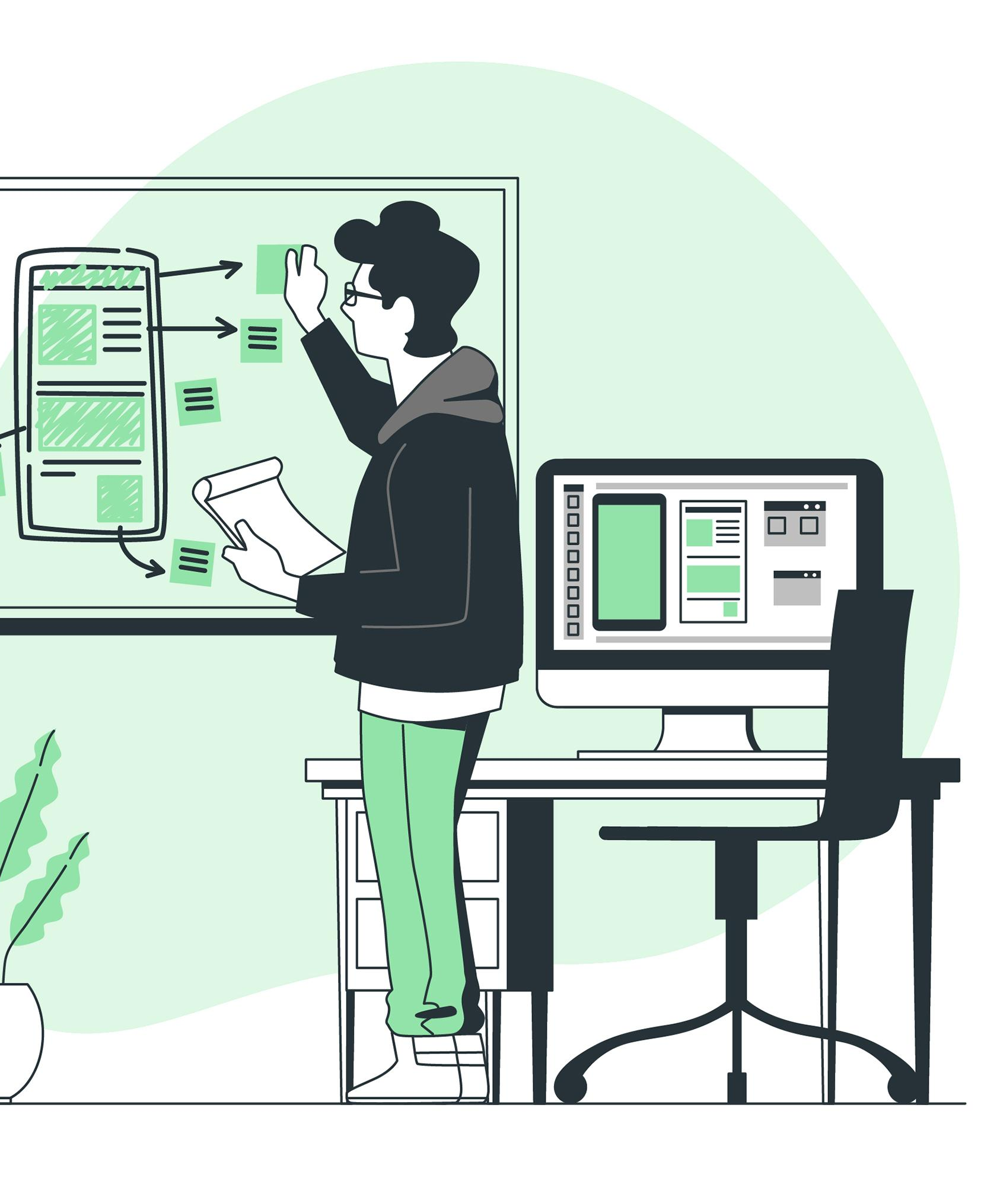
Introduction to Tkinter
Tkinter is a standard GUI (Graphical User Interface) toolkit for Python. It is a built-in library that comes with Python, making it readily available for developers. Tkinter is widely used for creating GUI applications in Python due to its simplicity and ease of use.
Tkinter allows developers to create interactive and visually appealing applications with minimal effort. It provides a wide range of widgets, such as buttons, labels, text boxes, and more, which can be easily customized to suit the needs of the application.

Slide 7
Outcome
Core Python: Understanding the fundamentals of Python programming language.
Tkinter Library: Learning to use Tkinter for creating GUI applications in Python.
Visual Studio Code (IDE): Working with an integrated development environment for Python programming.
GitHub: Managing and sharing code using version control.
Application Development: Developing a functional calculator application using Python.

Slide 8

Code Overview
Button Click Function: The click function is defined to handle button clicks. It takes a symbol argument, which represents the button that was clicked. The function updates the display based on the button that was clicked.
Creating the Display Area: A StringVar named display_var is created to hold the display value. It is initialized to an empty string. An Entry widget named display is created to display the current value of display_var. The Entry widget is configured with a font size of 18, a border width of 5, and it spans across all four columns of the window. It is also configured to expand and fill the available space in the window.

Slide 9
Creating Main Window
Creating the Main Window: A new Tkinter window is created using tk.Tk(), and its title is set to "Python Calculator".

Slide 10
Creating the Buttons
Creating the Buttons: Sixteen Button widgets are created to represent the digits 0-9, the arithmetic operators +, -, *, and /, the equals sign =, and the clear button C. Each button is configured with a width of 5 and a command that calls the click function with the appropriate symbol when the button is clicked. The buttons are arranged in a 4x4 grid using the grid method, with each button occupying one cell in the grid.

Slide 11
Running the main Loop Event
Running the Main Event Loop: The mainloop method is called on the main window to start the Tkinter event loop, which listens for user input and updates the display accordingly.

Slide 12

Testing and Debugging
The try and except statements in Python are used for error handling. The try block contains the code that may raise an exception, and the except block handles the exception if it occurs. This allows the program to gracefully handle errors and prevent the program from crashing.
The eval function is used to evaluate the mathematical expression entered by the user. If an error occurs during evaluation, such as a syntax error or division by zero, the except block is executed, and the display is set to 'Error'. This prevents the program from crashing and provides a user-friendly error message.

Slide 13

Conclusion
The Python Calculator project has provided us with a hands-on experience in creating a graphical user interface (GUI) application using the Tkinter library in Python. Through this project, we have learned the fundamentals of GUI programming, including creating widgets, handling events, and updating the display.

Slide 14
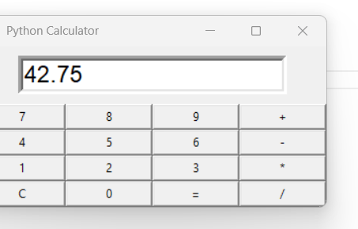
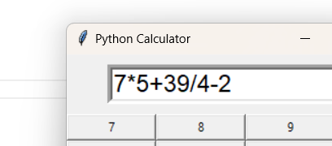
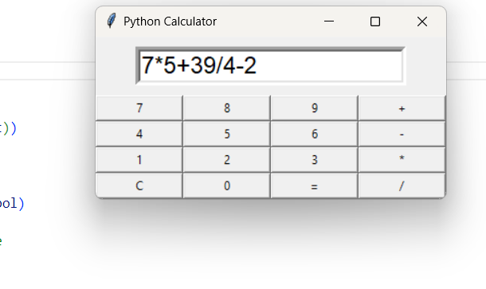
Snippets

Slide 15
Thank You

